Slide 1
CapitaLand IT Outsourcing Manage Services
Kick Off Meeting
27 April 2016

Slide 2

Agenda
Introduction
Transition & Transformation Plan
Transition Schedule
Stabilization Schedule
Transformation Schedule
Solutions Review
Architecture Review
People, Process, Tools
Project Governance
Project Steering Committee
Transition Organization
Operating Rhythm
Key Milestones & Deliverables

Slide 3

Agenda
Introduction
Transition & Transformation Plan
Solution Review
Project Governance
Key Milestones & Deliverables
1
2
3
4
5

Slide 4


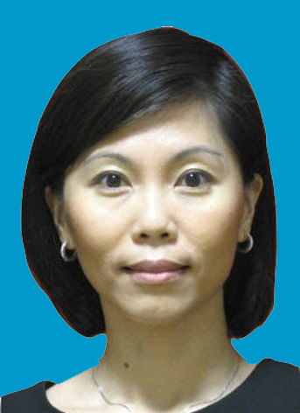
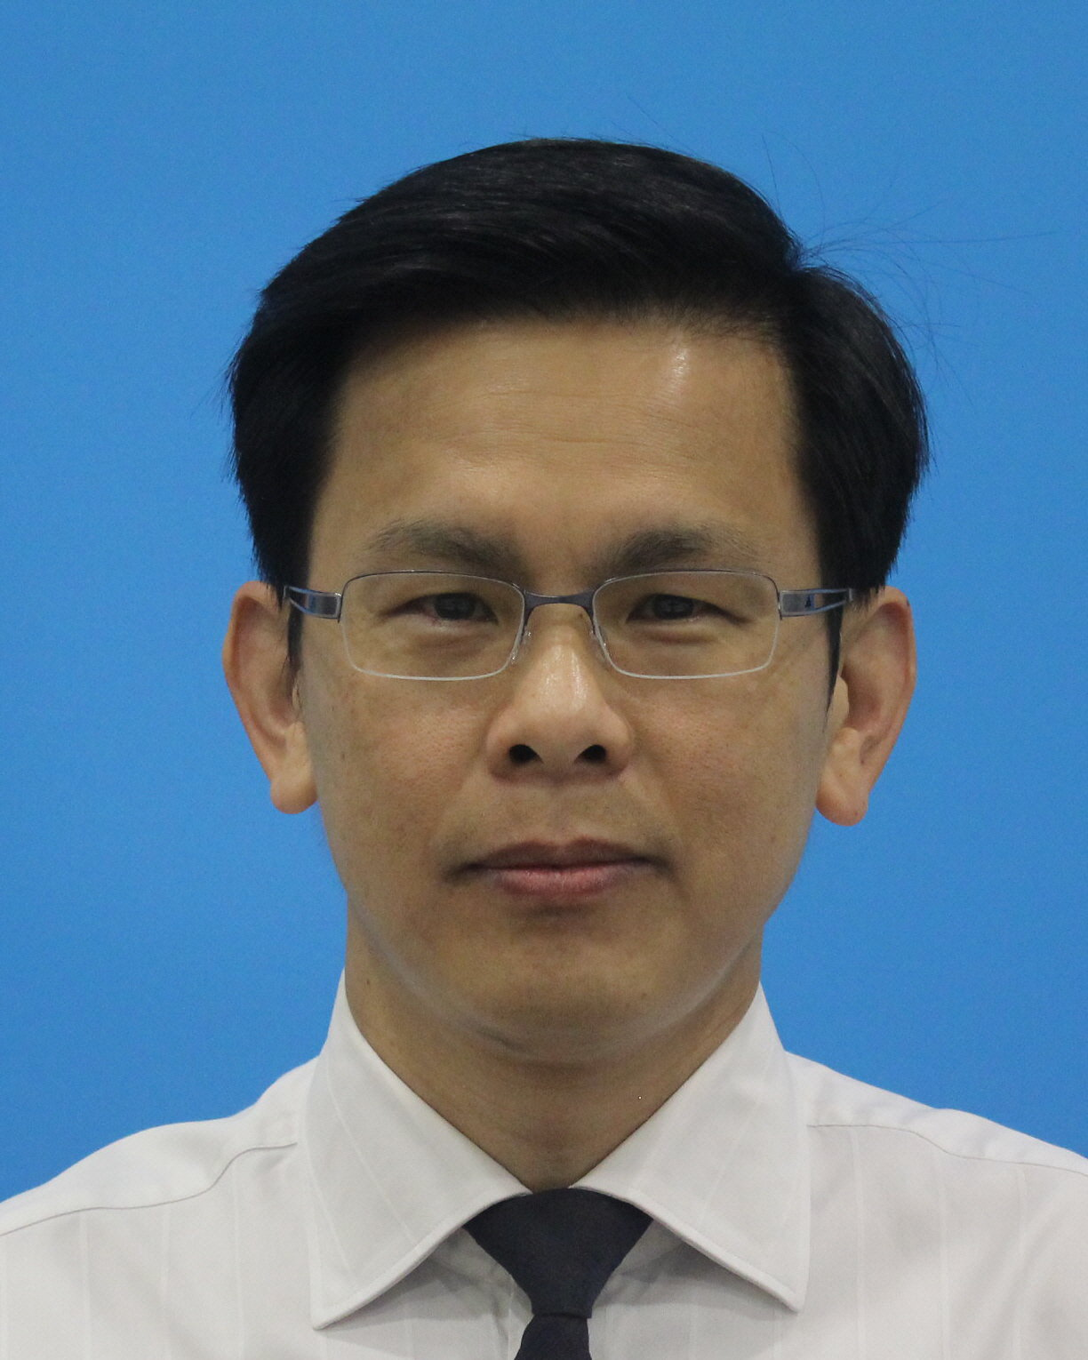
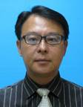

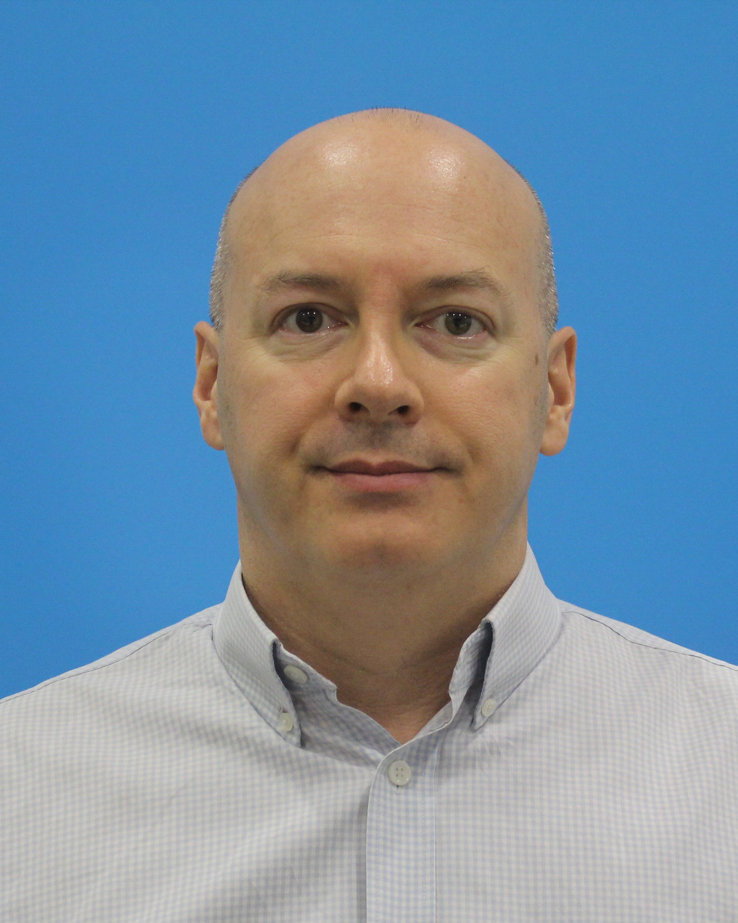
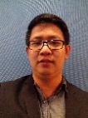
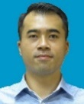
Introduction - The Singtel Team
Executive Sponsor
Executive Sponsor
Cheong Yen Niap
Head Enterprise
Business
Sandip Gupta
VP, Emerging Businesses
Account Management Team
Solution & Delivery Team
Delivery Director
Cloud Architect
David Tan
Director, Cloud Sales, Architects & Delivery
Ronald Lim Kok Leong
Cloud Architects
Lena Ng
Head Sales, Business Sales
Project Director
Cloud Delivery
Cloud Specialist
Paul Southern
Project Director,
Cloud Delivery
Yeo Choon Siong
Cloud Architect,
Cloud Delivery
Ivan Tiu
Cloud Business Development Manager
Nyx Ching
Enterprise Account Manager

Slide 5
Agenda
Introduction
Transition & Transformation Plan
Solution Review
Project Governance
Key Milestones & Deliverables
1
2
3
4
5

Slide 6
Transition and Transformation Management
27 Apr
01 Jul
01 Aug
01 Sep
01 Dec
27 Apr
Transition
01 Jul
01 Jul
Stabilization
01 Sep
01 Sep
Transformation
01 Dec
Transition
Process and SOP baseline
Tools monitoring and management
Operations As-Is take over
Stabilization
Operation process stabilization
Tools information collection and fine tuning
Transformation
Transform object CI Management to Services management
Improve operation management and monitoring uptime
Optimize resources and tools based on services management

Slide 7
Transition Schedule
0. Kick Off
1. Information Gathering
2. Clarification Workshop
3. Baseline SOP Processes
4. Tools Deployment ITSM + Portal Server Monitoring Network Monitoring ITAM System / Desktop Management
5. Staff Onboarding EUC SD Agents SME
15 Apr
01 May
15 May
01 Jun
15 Jun
01 Jul
Ongoing
27 Apr
18 Apr
13 May
09 May
13 May
30 May
03 Jun
01 May
01 May
ITSM + Self Service Portal
15 Jun
06 May
Server Monitoring
15 Jun
Agent Roll Out
06 May
Fine - Tuning
Network Monitoring
15 Jun
06 May
IT Asset Management
15 Jun
06 May
15 Jun
System / Desktop Management
Agent Roll Out
15 Jun
Fine - Tuning
09 May
15 Jun
09 May
EUC Engineers
15 Jun
21 May
Service Desk Agents
15 Jun
16 May
SME
15 Jun

Slide 8
Stabilization Schedule
27 Apr
01 Jul
01 Aug
01 Sep
01 Dec
27 Apr
Transition
01 Jul
01 Jul
Stabilization
01 Sep
01 Sep
Transformation
01 Dec
Stabilization Phase
BAU operates as it is
CMDB collection
Trend collection and analysis reporting
System and desktop baseline standardization
Project reports fine-tuning

Slide 9
Transformation Timeline - Asset Management
1. Centralized Remote Control via Console
2. Centralized Patch Management with automated Deployment
3. Centralize Application Deployment
4. Self-Service Application Deployment
5. Software Metering
6. Centralized Corporate Image Deployment Via OS deployment
7. Centralized Reporting
Sep
Oct
Nov
Dec
Jan
Feb
Ongoing
01 Sep
01 Oct
01 Sep
01 Nov
01 Sep
01 Nov
01 Oct
01 Nov
01 Oct
01 Dec
01 Oct
01 Jan
01 Sep

Slide 10
Transformation Timeline - System and App Monitoring
1. Platform Baseline Monitoring
2. Application Baseline Monitoring
3. Automated ITSM Ticketing System from Monitoring Events.
4. Monitoring Dashboard with SLA
5. Platform Performance Monitoring 6. Application Performance Monitoring 7. Monitoring Finetune 8. Enhanced Reporting
Sept
Oct
Nov
Dec
Jan
Feb
Ongoing
01 Sept
01 Oct
01 Sept
01 Nov
01 Sept
01 Nov
01 Oct
01 Nov
01 Nov
01 Jan
01 Dec
Ongoing
01 Jul
Ongoing
01 Jul
Ongoing
01 Jul
Ongoing

Slide 11
Transformation Timeline - ITSM & Portal
Jan
Feb
Ongoing
1. Mobile Portal Page Compatibility
2. Online Help Chat Module
3. Shopping Cart Bundling
Sep
Oct
Nov
Dec
01 Sep
01 Oct
01 Sep
01 Nov
01 Sep
01 Feb
Notes:
Mobile Portal Page Compatibility = Page must be fully supported for all mobile platform devices
Online help chat module = user can login to portal for on-the-fly assistance without the need of logging any cases, assist to reduce the amount of cases in servicenow eventually
Shopping Cart Bundling = bundling of services request (such as service request for a laptop that bundle with software like Microsoft project), once request is submitted, it will split into multiple service request for processing, however delivery to end user would be a single end-point rendering of services.

Slide 12
Transformation Timeline - Solarwinds
0. Onboarding Remote Site
1. Customization Alerts on Network Devices
2. Refining Baseline Compliance
3. Centralized Reporting
4. Refining Network Topology
5. Adding Polling Engine for WIFI and Remote Site
01 Jul
01 Aug
01 Sep
01 Oct
01 Nov
01 Dec
Ongoing
01 Jul
Onboarding Remote Site
31 Dec
01 Jul
Customization Alerts on Network Devices
01 Aug
Refining Baseline Compliance
15 Oct
01 Jul
Centralized Reporting
15 Jul
Refining Network Topology
01 Sep
Polling Engine
01 Oct

Slide 13
Agenda
Introduction
Transition & Transformation Plan
Solution Review
Project Governance
Key Milestones & Deliverables
1
2
3
4
5

Slide 14
Solution Review: Overall Architecture
Notes:
Include HP-UX, SAP, Oracle
How to differentiate between managed and non-managed
LiquidSky = Cloud Spend/Usage Optimizer

Slide 15
People, Process, Tools
Tools | Processes | Singtel | CL Infra | CL EUC
ITSM
Service Now | Incident Management | James | Susie Chia | Wai Pin
 | Problem Management | James | Susie Chia | Wai Pin
 | Change Management | James | Susie Chia | Wai Pin
 | Service Level Management | James | Susie Chia | Wai Pin
 | Service Catalog | James | Susie Chia | Wai Pin
 | Knowledge Based | James | Susie Chia | Wai Pin
Self Service Portal | Incident Management | Melvin | Susie Chia | Wai Pin
 | Problem Management | Melvin | Susie Chia | Wai Pin
 | Change Management | Melvin | Susie Chia | Wai Pin
 | Service Level Management | Melvin | Susie Chia | Wai Pin
 | Service Catalog | Melvin | Susie Chia | Wai Pin
 | Knowledge Based | Melvin | Susie Chia | Wai Pin
System and Desktop Management
System Center Configuration Manager (SCCM) | Asset Management (Computer Devices) | Wai Yip, Boon Hock | Susie Chia | Wai Pin
 | Patch Management | Wai Yip, Boon Hock | Susie Chia | Wai Pin

Slide 16
People, Process, Tools
Tools | Processes | Singtel | CL Infra | CL EUC
Network Monitoring
Solarwind Network Performance Monitoring (NPM) | Event Management | David Wong, Alphonsus | Susie Chia | NA
 | SLA Management | David Wong, Alphonsus | Susie Chia | NA
Solarwind Network Configuration Manager (NCM) | Asset Management (Network Devices) | David Wong, Alphonsus | Susie Chia | NA
 | Event Management | David Wong, Alphonsus | Susie Chia | NA
System Monitoring
System Center Operation Manager (SCOM) | Event Management | Ralph | Susie Chia | NA
 | SLA Management | Ralph | Susie Chia | NA
PIWIK | Event Management | Wai Yip | Susie Chia | NA
SMS Gateway | Event Management | Alphonsus | Susie Chia | NA

Slide 17
Agenda
Introduction
Transition & Transformation Plan
Solution Review
Project Governance
Key Milestones & Deliverables
1
2
3
4
5

Slide 18
Transition and Transformation Overview
Directing
TTM
Presales
Transition
Transformation
Steady State
Basic Transition
(no new build required)
New build required for Transition
New build required for Transformation
Managing
Presales
PMM
PMM
PMM
SMM
DBM
DBM
Delivering
D&B
Activities
D&B
Activities
D&B
Activities
M&O Activities
PMM = Project Management Methodology
DBM = Design and Build Methodology
SMM = Service Management Methodology

Slide 19
Programme Governance
TRANSITION / STEADY STATE
Program Steering Committee
CapitaLand Senior Management
Strategic Direction
Conflict / Issue Resolution
Risk Resolution
Singtel Senior Management
Project Management Committee
CapitaLand
- Project Board Member
Singtel - Project Board Members
Tactical
Execution

Slide 20
Governance
Strategic Level
Strategic Alignment to Business Goals
Set IT Direction & Goals
Steering
Committee
Tactical Level
Translating Strategies into Action Plans
Contract Management
Technical & Delivery Leadership
Status &
Escalation
Management
Committee
Innovation
Office
Operational Level
Infrastructure Support & Maintenance
Service Request Management
Transition Management
Implementation Management
Committee
Operation Management & Service Delivery

Slide 21
Steering Committee
Singtel Project Sponsor
Sandip, Yen
Service Delivery Director
David Tan
Service Delivery Manager
Yeo Choon Siong
CapitaLand Project Sponsor
Mung Hou
EUC & SD Management
Nicholas Too
Infra Management
Eric Wong
Change Manager Paul Southern
Change Manager TBC

Slide 22
Transition Organisation Chart (INFRA & EUC)
Service Delivery Director
David Tan
ITIL Advisor
TBC
INFRA
Operation Manager (SG)
David Wong
Service Delivery Manager
CS Yeo
EUC
Operation Manager
Alphonsus. J
Service Desk Manager
Wong Kar Wai
Process Manager
James Tan
EUC Manager
Tristan Cheong
Transition
Project Director
Paul Southern
Operation Manager (CN)
TBC
Technical Solution Manager
Au Wai Yip
Governance
Shared Resources
1 x
18 x
Operations
4 x
6 x
20 x
4 x
5 x

Slide 23
Operating Rhythm
Weekly Transition Meeting
Project team to meet on a weekly basis to discuss on the progress, share updates, upcoming tasks and resolve issues.
EUC Weekly Status Meeting
[2:00PM-3:30PM], Every Monday & Thursday)
Infra Weekly Status Meeting
[2:00PM-3:30PM], Every Tuesday & Friday)
Steering Committee Meeting
Steering Committee meeting will be called for when there are any road blocks / show stoppers / critical challenges faced by the Project team and for key decision making (budget approval, phase closure sign off etc.)

Slide 24
Communication Plan
TYPE | PURPOSE | STAKEHOLDER (AUDIENCE) | FREQUENCY & SCHEDULE | METHOD OF COMMUNICATION / MEDIUM
EUC Weekly Status Meeting (SG) | To discuss on the progress Share updates Track milestone Upcoming tasks Resolve issues | Singtel – Yeo, Tristan, Alphonsus, James CapitaLand – Wai Pin, Peter, Kar Siong, Kok Soon, Gan Seng, Ethan | Weekly. Every Monday & Thursday [2:00PM-3:30PM] | Face-to-face meeting WebEx
Infra Weekly Status Meeting (SG & CN) | To discuss on the progress Share updates Track milestone Upcoming tasks Resolve issues | Singtel – Yeo, David, James CapitaLand – Susie, Sean, Soon Seng, Li Yang | Weekly. Every Tuesday & Friday [2:00PM-3:30PM] | Face-to-face meeting WebEx

Slide 25
Agenda
Introduction
Transition & Transformation Plan
Solution Review
Project Governance
Key Milestones & Deliverables
1
2
3
4
5

Slide 26
Key Milestones & Deliverables
BASELINE TRACK (EUC & INFRA) | DATE
ITSM Process Standardization Incident Management Problem Management Change Management (CAB) Knowledgebase Management Service Level Management | 27th April 2016
Command Center Readiness Command Center Facilities Readiness Call Center & IVR System Phone Lines & Toll Free Number Service Desk Agents Onboarding Support Staff Onboarding | 15th June 2016

Slide 27
Key Milestones & Deliverables
INFRA TRACK (SG AND CN) | DATE
Asset inventory and baseline identification | 6th May 2016
SOP baseline identification | 13th May 2016
Hardware and Software Procurement | 26th May 2016
VPN Network Connectivity | 22th June 2016
Hyper-visor Readiness | 20th June 2016
Tools Readiness Self Service Portal ServiceNow Solarwinds Network Monitoring SCOM System & Application Monitoring SCCM Server Management SMS Gateway | Self Service Portal – 15th June ServiceNow – 22nd June Solarwinds -15th June SCOM – 20th June SCCM – 16th June SMS Gateway – 11th May

Slide 28
Key Milestones & Deliverables
EUC TRACK (SG) | DATE
Existing Service Desk Workflow Management Workshop | 6th May 2016
Asset inventory and baseline identification | 1st June 2016
EUC Field Engineer Onboarding | 15th June 2016
SOP baseline identification | 20th June 2016
Tools Readiness Self Service Portal ServiceNow SCCM Desktop Management Asset Management Patch Management Software Deployment OS Deployment Baseline Configuration Management Remote Desktop Management | Self Service Portal – 15th June ServiceNow – 8th June Asset Management – 23rd May Software Deployment – 23rd May OS Deployment – 30th May Baseline – 23rd May Remote Desktop – 20th May

Slide 29
Q&A Session

